Slide 1


Episode 8
Introducing the
Christian Life
Intro Series is produced by Out of the Box (Scotland) Ltd. Copyright @ Out of the Box 2023. All rights reserved.

Slide 2

Watch episode 8
Episode 8
Video
What you will need:
Access to the internet
Pencil or pen
Blank piece of paper
Click on the image above to be taken to the episode video hosted on YouTube.

Slide 3
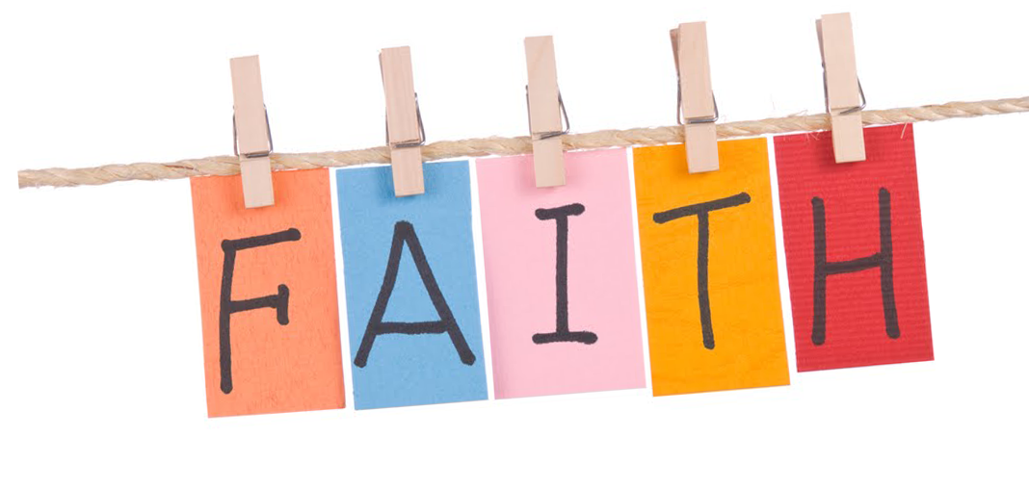
Having faith is not just for people who are "religious!" When you think about it, there are loads of things we put our faith in. Everyday decisions are actually based on having faith. Things like trusting that cars will stop at a red light, so we are safe to cross the road.
Are you sitting on a chair right now? Why?
What makes you think the chair won't just collapse underneath you? Your decision to sit on the chair is an act of faith - you put your trust in the chair despite not knowing for certain it will hold you!
Write down some things that people put their faith in.
Episode 8
Group Chat
What you will need:
Groups of 4-6
Pencil or pen
Blank piece of paper
Remember that faith isn't necessarily a religious belief, but where someone puts their trust in someone or something else. Try to be creative - when you share them with the rest of the class, only the unique ones will score points!

Slide 4


Fact File
Imagine you have to describe Christianity to an alien who has just landed on the planet (but can understand what you say with no problems at all).
Using everything you have learned during Intro Series lessons, what would you say
the main things are?
Remember things like beliefs,
practices, stories, facts, etc.
You can work in pairs or small group.
Episode 8
Research
What you will need:
Computer
Pencil or pen
Blank piece of paper

Slide 5

After watching the episode, I have learned:
Think about the STOP
model for prayer
(from the episode).
Do you remember what each letter stands for?
Try to think about the sorts of things Christians might say to God for each of these.
Write down your ideas.
Even if you are not somebody who prays or has a religious faith, it can be good to think about the sorts of things in the STOP model.
Why not STOP and think for yourself? What are the things you're sorry for, thankful for, who are the people you care about and
what things do you hope for?
Write or draw some ideas.
Episode 8
Reflection
What you will need:
Pencil or pen
Blank piece of paper
What is so good you just can't keep it to yourself?

Slide 6
Quiz Time
These links will take you to the digital version of the quizzes or you can use the following slides for the non-digital version.
Episode 8
Quiz
Episode Quiz
How well can you remember what you have learnt about the Bible?
Click here for the
Episode Quiz
Observation Quiz
How well can you remember what you saw during the
drama section of the video?
Click here for the
Observation Quiz
What you will need:
Access to the internet
Pencil or pen
Blank piece of paper

Slide 7
Quiz Time
How well can you remember what you have learned about the
Christian Life?
What was Alex sitting in at the start of the episode?
How do Christians talk to God?
Alex describes prayer like having a conversation on what?
What is the prayer Christians often pray when they gather together?
What was the word used to help us think about prayer?
What does the letter S stand for?
What does the letter T stand for?
What does the letter O stand for?
What does the letter P stand for?
You are unlikely to hear that Christians say they know all the answers. True or False?
Episode 8
Quiz
What you will need:
Pencil or pen
Blank piece of paper

Slide 8
Observation Quiz
How well can you remember what you saw during the
drama section of the video?
What was Zack playing with at the table?
Who did Zack want to do his sermon as?
What colour was Zack’s shirt?
Rev Alan suggested to Zack that prayer was a good place to find courage? True or False?
What did Rev Alan offer Zack after he drank some tea?
What was the hymn number at the top of the board in the church behind the pulpit?
Who was sitting next to Rev Alan in the church?
What book of the Bible was Zack preaching from?
What did Tim want to do the next time Zack would be preaching?
Where did Tim end up at the end of the episode?
Episode 8
Quiz
What you will need:
Pencil or pen
Blank piece of paper

